Slide 1

The Awesome Music Recommendation Engine
JDE03

Slide 2

THE WHY
Can music improve an individual's mood and overall mental health? If so, what should I be listening to?
We analyzed a survey of respondents regarding their listening habits and the effect of music on their self-reported mental health, and based on the data, create a recommendation engine which serves a selection of music based on how the user is feeling.
! Disclaimer: This is a data engineering project. No research was carried out and no claims are made regarding the song recommendations. Listen at your own risk!

Slide 3

WHERE [0]
KAGGLE
We retrieved the MxMH (Music & Mental Health) dataset in the form of a .csv file from Kaggle¹. @catherinerasgaitis collected the data via a Google Form which was posted online in various forums. We were interested in 2 main 'blocks' of data:
Block 1: Music Genres
Respondents ranked how often they listen to 16 music genres, where they can select Never / Rarely / Sometimes / Very frequently
Block 2: Mental Health
Respondents rank Anxiety, Depression, Insomnia, and OCD² on a scale of 0 to 10, where:
0 - I do not experience this.
10 - I experience this regularly, constantly/or to an extreme.
Most importantly, respondents indicated whether music had 'No effect', or did indeed 'Improve' their mental health.
https://www.kaggle.com/datasets/catherinerasgaitis/mxmh-survey-results/data

Slide 4
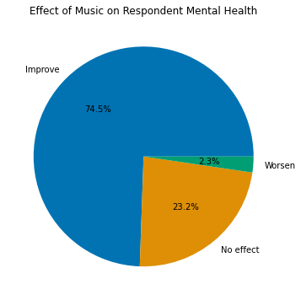
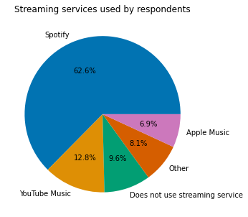
SUMMARY CHARTS
74.5% of respondents indicated that music improved their mental health
62.6% of respondents primarily use Spotify to listen to music

Slide 5

WHERE [1]
Spotify
Having analysed the MxMH dataset, we then set out to create a recommendation engine where we could recommend music to users based on their current mental health condition.
Being one of the largest music streaming service providers, we naturally picked Spotify as a source of music data.
62.6% of respondents also indicated that their primary source of streaming music was Spotify.
Although we had no experience with API's (Application Programming Interface), we found that Spotify had a very useful guide for developers wishing to retrieve data from them¹.
We thus set out to extract song recommendations from Spotify, based on the genres which respondents to the MxMH survey said helped to improve their mental health conditions.

Slide 6






5
1
Extract
Transform
Load
3
4
6
2
7
MxMH dataset retrieved from Kaggle as .csv file
3 songs per each of 16 genres retrieved from Spotify via Web API
Data is cleaned and transformed in Python
Data is loaded into data pond (ElephantSQL DB)
Data made available to Data Analyst
Data made available to Recommendation Engine
Recommendation Engine calls Spotify API for other recommendations
Images from Vecteezy.com & Flaticon.com

Slide 7
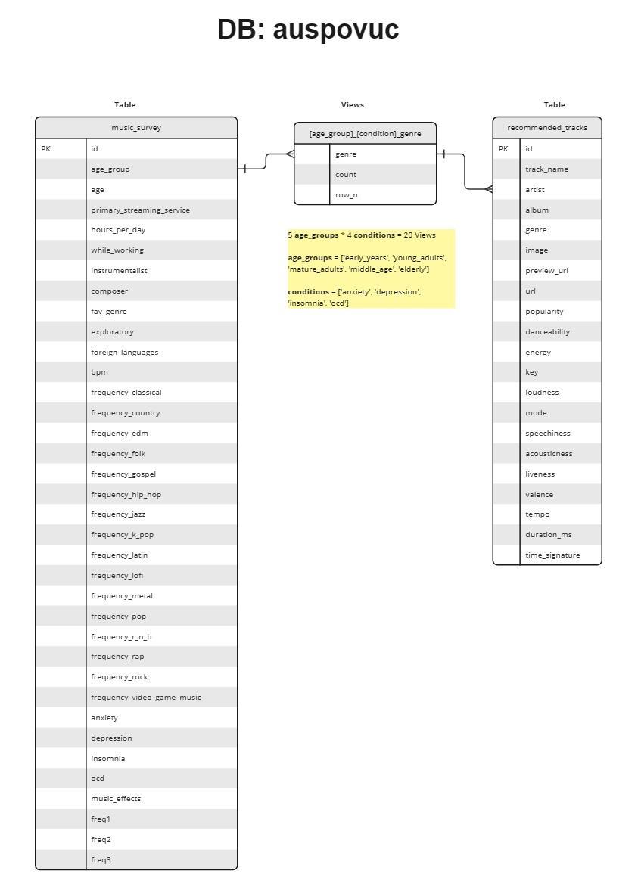
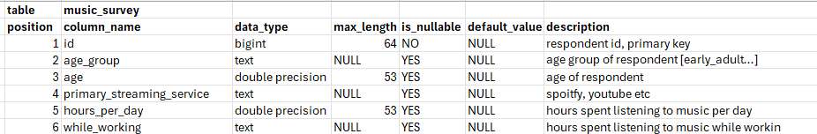
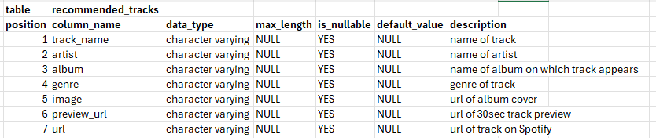
ERD & Data Dictionaries
on Github
https://github.com/leepiau/mmh

Slide 8
Tools
PgAdmin – Access local and cloud databases
ElephantSQL – cloud database
Jupyter notebook – coding tool
Pycharm – python ide
Github – code repository
MS Copilot – AI tool
Chatgpt – AI tool
Stackoverflow – coding reference
W3schools – coding reference

Slide 9

Challenges
No prior experience with writing API calls
Beginners' level knowledge of SQL, Python and data engineering concepts
Balancing project work with coursework
Strategy​
Start with individual attempts at end-to-end solution
Share ideas, approach and code
Select a single approach for each are

Slide 10

Learnings
cURL commands for API requests
Spotipy is a very useful python library to work with Spotify's Web API :)
Button widgets on Python
Manipulating data with dataframes
Power of running SQL commands in Python; ability to loop and pass variables into statements
Query for database information without the benefit of a nice GUI
Parse json data/extract information
Using Views, Unnest, Cross Join Lateral
Collaborating, using Github

Slide 11

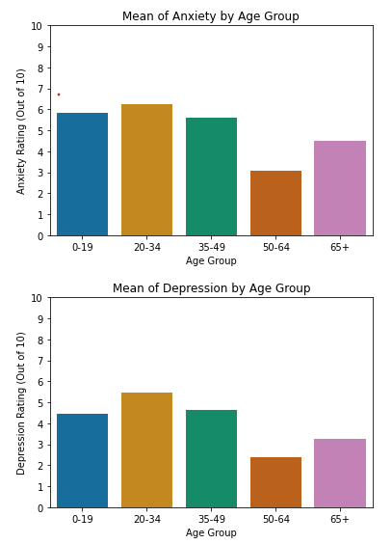
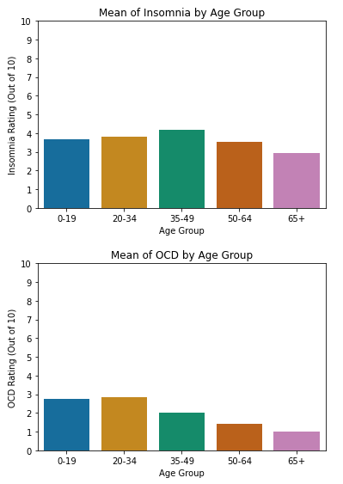
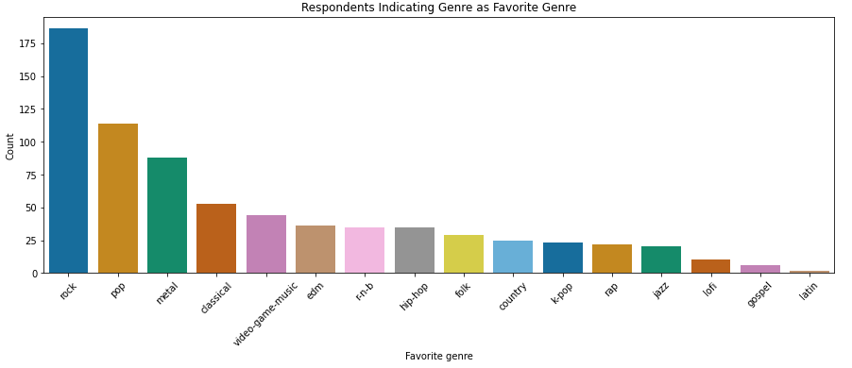
Findings / Analysis
Main issue: Anxiety
Most popular, effective genre: ROCK!

Slide 12

Recommendation Engine
What's your age group
Do you relate to any of these condition
Check out these tracks
Personalized music recommendations tailored to the individual characteristics
Potential to improve mood and well being
Enhances the user experience by reducing the hassle to search for a song

Slide 13
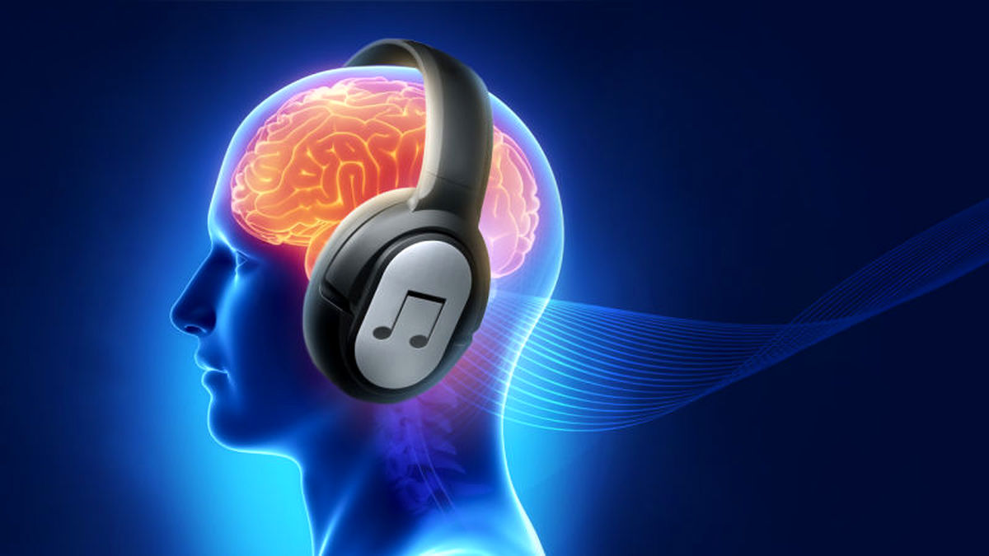
Phase II
Normalize data
Search for recommendations for genres not in Spotify's list of genres
Explore combination of mental issues to provide better recommendations
Added personalization to better tailor to their need
Interface enhancements
Feedback mechanism to generate more data for better algorithm

Slide 14

Thank You

